Slide 1
Apache arrow: the hidden champion of data analytics
article: https://maximilianmichels.com/2020/apache-arrow-the-hidden-champion/
presented by justin Ehly, ds6306, tu630p

Slide 2

“A cross-language development platform for in-memory analytics.”

Slide 3
benefits of apache arrow
A new library in the data processing and data science space
Provides
In-memory computing (think FAST!)
Standardized columnar format (cheaper – little to no cost to transfer data between systems)
An IPC and RPC framework for data exchange between processes and nodes respectively
“Arrow is like visiting Europe after the EU and the Euro: you don't wait at the border, and there are one currency is used everywhere.” – https://www.dremio.com/apache-arrow-explained/

Slide 4
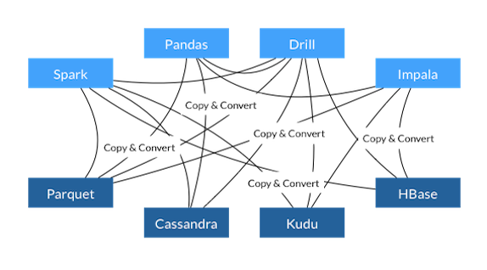
before arrow
Costly Serialization: Each database and language has to implement its own internal data format
Wasted time – develop new algorithms
Wasted memory – if you need to work on a 20G file and only have 16G of memory
Wasted bandwidth – swapping data across a network or the web
Wasted money – to pay for the time, memory and bandwidth
e.g. Parquet represents a number differently than Python
Think wrangle-tidy-untidy-retidy data)

Slide 5
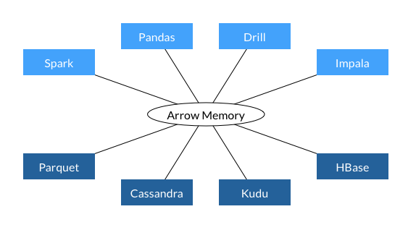
with arrow
Arrow reads and operates on the data directly
Created a new file format with operations that work directly on the serialized data.
Data read directly from the disk without need to load into memory and convert/ deserialize
Still loads data into RAM, but Arrow uses memory-mapping to only load as much data into memory as necessary and possible

Slide 6
Standardized column storage format
standard database
read row by row
for quick summaries, have to read all records and extract data
columnar database
column data in one place and can be efficiently iterated over (repeatedly processed)
takes advantage of modern cpu architecture
a.k.a. simd (single instruction multiple data)
very efficient with caching and pipelining at the processor level
Player | Height | Position
Messi | 5’7 | RF
Ronaldo | 6’2 | ST
Neymar | 5’9 | LW
De Gea | 6’4 | GK
De Bruyne | 5’11 | RCM
Player | Messi | Ronaldo | Neymar | De Gea | De Bruyne
Height | 5’7 | 6’2 | 5’9 | 6’4 | 5’11
Position | RF | ST | LW | GK | RCM

Slide 7
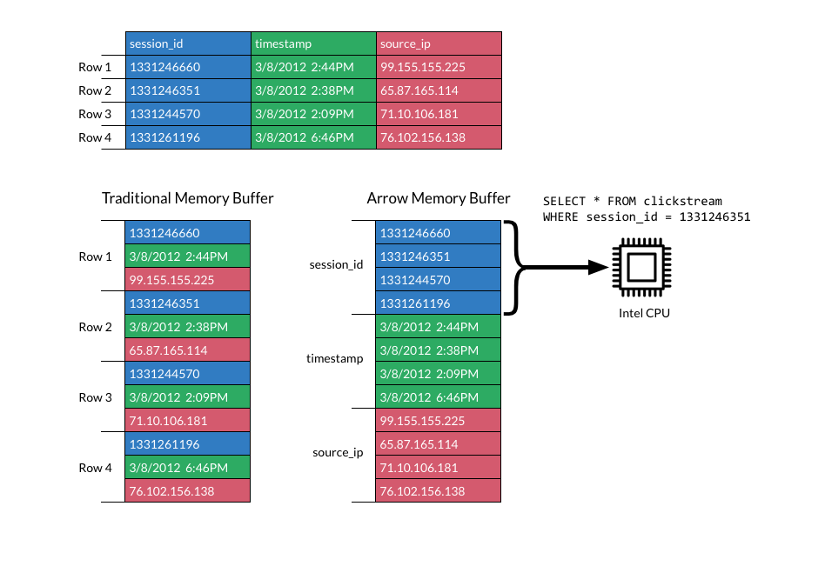
how much faster?
According to Dremio:
PySpark: IBM measured a 53x speedup in data processing by Python and Spark after adding support for Arrow in PySpark
Parquet and C++: Reading data into Parquet from C++ at up to 4GB/s
Pandas: Reading into pandas up to 10GB/s
SIMD (single instruction multiple data)

Slide 8
IPC/ RPC Framework
IPC (inter-process comm)
rpc (remote procedure call)
Data can be exchanged between languages without having a local copy
Only necessary columns need to be transferred across networks, not entire datasets
Again – do not have to deserialize data
Flight – project within Arrow
Optimized for parallel data access
Multi-task data calls without having to wait for one process to end before staring another one
Dremio observed a 20-50x boost in performance using its Arrow Flight connector over TPC in lieu of ODBC
ODBC – Open Database Connectivity (ODBC) is a standard application programming interface (API) for accessing database management systems (DBMS), created in 1992 and runs at
TCP – computers connecting over the internet

Slide 9
Language Support for apache arrow
C++
C#
Go
Java
JavaScript
Rust
Python (through the C++ library)
Ruby (through the C++ library)
R (through the C++ library)
MATLAB (through the C++ library).

Slide 10
What’s on the horizon?
Query Engine for Arrow appears to be on the horizon
DataFusion was donated to Arrow (Rust-based query engine)

Slide 11
acknowledgements
https://www.datascienceweekly.org/
https://maximilianmichels.com/2020/apache-arrow-the-hidden-champion/
https://arrow.apache.org/overview/
https://www.dremio.com/apache-arrow-explained/
https://en.wikipedia.org/wiki/Open_Database_Connectivity#:~:text=In%20computing%2C%20Open%20Database%20Connectivity,database%20systems%20and%20operating%20systems.
Images from the Apache Arrow Website.

